Slide 1

Introduction to DevOps
Ganesh Palnitkar

Slide 2
Agenda
What’s DevOps
DevOps - Agile relation
DevOps for me / my team ?
DevOps challenges
DevOps Benefits
Best practices

Slide 3
Introduction to DevOps

Slide 4
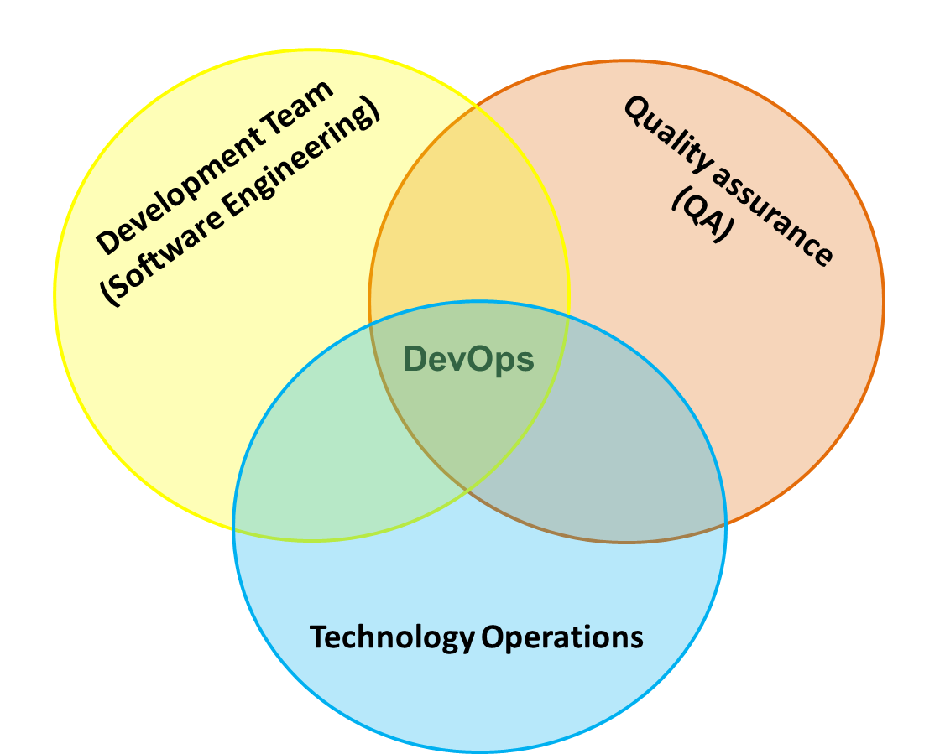
What’s DevOps?
DevOps is a software development and delivery process that emphasizes communication and collaboration between Product Development Team, QA Team, Operations Team and Business owners to increase organization's ability to deliver application and services at high velocity.
This speed enables organizations to better serve their customers and compete more effectively in the market.
DevOps building blocks:
Code
Build
Test
Packaging
Release management
Configuration management
Application and Infrastructure monitoring
Development and QA Team
Operations Team

Slide 5
Development V/s Operations
Developers want change
Deliver bug-fixes, changes and new features.
The main task of the development team is to fulfil the customer’s requirements, test the solution, and provide software updates in quick succession. New features that have been implemented and tested by the developers add potential value for the customer.
On one hand, the development team wants change. On the other hand, the operations team is mainly interested in reliable and stable software environment. Every change forwarded by the development team can endanger the existing reliability and stability of production environment.

Slide 6
DevOps Drivers
Market competition
Ever-changing business needs
Quick to market requirement
Tight delivery deadlines
“The code works on my machine” – blame game
Disconnect bet’n Development and Operations team.
Conflict Scenarios
Conflict during deployment
Conflict after deployment
Conflict about performance
Advantages of agile processes like Scrum, Kanban are often nullified because of the obstacles to collaboration, processes, and tools that are build up in front of operations. Because of this achieving delivery timelines for a sprint becomes challenging.

Slide 7
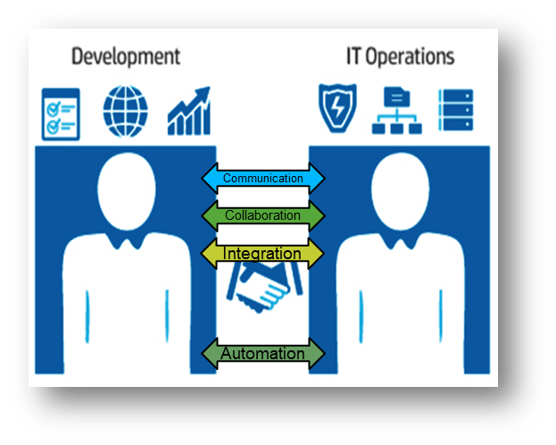
DevOps Culture
DevOps is more than just a tool or a process change; it inherently requires an organizational culture shift. This cultural change is especially difficult, because of the conflicting nature of departmental roles:
Operations — seeks organizational stability
Developers — seek change
Testers — seek risk reduction

Slide 8
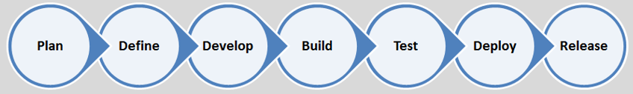
Development methodologies - comparison
Conception
Initiation
Analysis
Design
Construction
Testing
Deployment
Traditional
Deliverables
Requirements
Design
Code
Test
Deploy
Requirements
Design
Code
Test
Deploy
Agile
Iteration 1
Iteration 2
DevOps – workflow automation

Slide 9
Agile Methodology
Agile Model
Agile method proposes incremental and iterative approach to software design.
The agile process is broken into individual models that designers work on.
The customer has early and frequent opportunities to look at the product and make decision and changes to the project.
Agile model is considered unstructured compared to the Traditional (waterfall) model.
Small projects can be implemented very quickly. For large projects, it is difficult to estimate the development time.
Error can be fixed in the middle of the project.
Development process is iterative, and the project is executed in short (2-4) weeks iterations. Planning is very less.
Documentation attends less priority than software development
Every iteration has its own testing phase. It allows implementing regression testing every time new functions or logic are released.
In agile testing, when an iteration ends, shippable features of the product is delivered to the customer. New features are usable right after shipment. It is useful when you have good contact with customers.
Testers and developers work together.
At the end of every sprint, user acceptance is performed.
It requires close communication with developers and together analyse requirements and planning.

Slide 10
Agile Scrum Framework at a glance
working in iterations,
build cross-functional teams,
appoint a product owner and Scrum master,
introducing regular meetings for iteration planning,
daily status updates,
sprint reviews

Slide 11
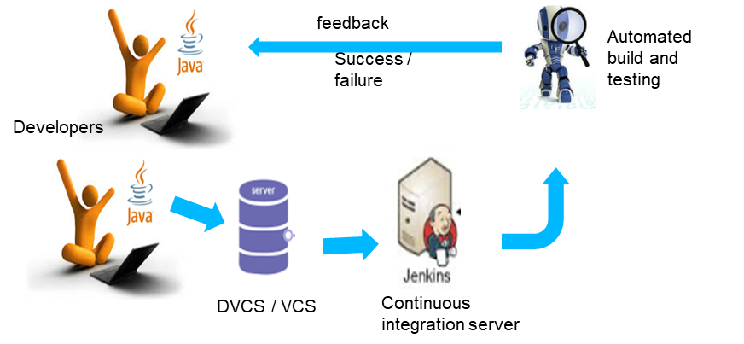
DevOps for Development and QA
Continuous Testing enabled with,
Continuous integration.
Continuous integration is software development practice in which team members integrate their work frequently, leading multiple integrations per day. Each integration helps to reveals integrations errors in build success / failures as quickly as possible. This helps in significantly reducing integration problems and delivery timeline.

Slide 12
DevOps for IT Operations
Integrated environment provisioning
Dynamic environment provisioning
Containerized app deployment and Data Center Management
Continuous application deployment
Single click deployment
Continuous monitoring –
Performance monitoring
System and application monitoring
Log analysis

Slide 13
DevOps for Business owners
Quick to Market
Agility
Environment stability
Fast recovery
Fully automated deployments
Customer satisfaction
Improvement in product quality
Quick turn around time

Slide 14
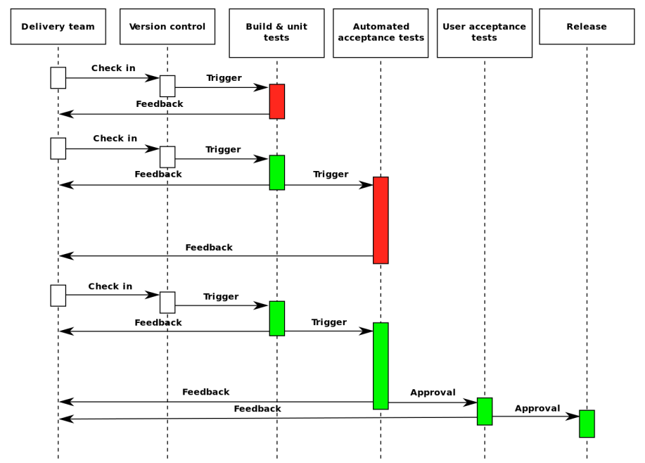
Continuous delivery pipeline
Source: Continuous Delivery: Reliable Software Releases through Build, Test, and Deployment Automation

Slide 15
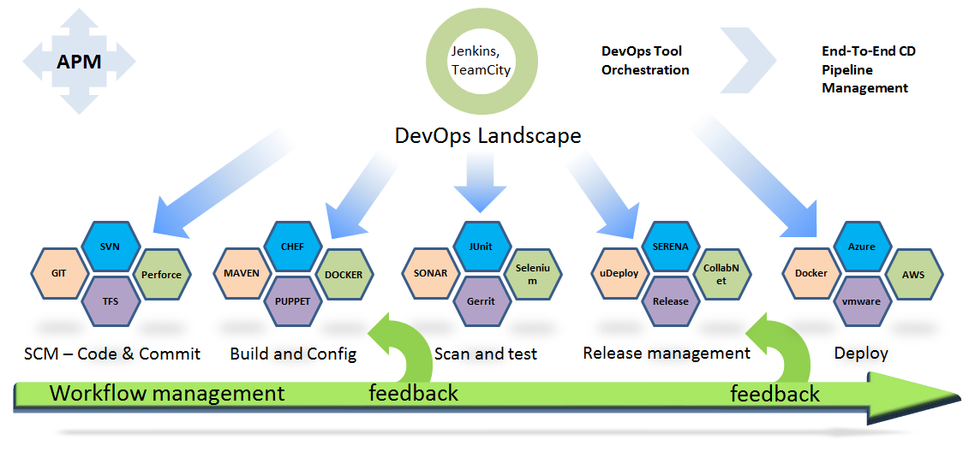
DevOps landscape

Slide 16
Common goals of an enterprise DevOps practice
Increased deployment frequency
Reduced lead time for changes
Faster recovery when problems occur
More robust and better integrated security
A “shift left” in quality – start testing in an earlier phase.
Fast feedback loops and effective communication between teams and departments

Slide 17
Challenges in implementing DevOps!
Establishing DevOps culture.
Implementing change in application development environment.
Environment upgradation (standardization)
Application complexity.
Budget
Availability of skillset

Slide 18
Best Practices in DevOps
Active partnership and close coordination among the stake holders in establishing DevOps culture.
Implement DevOps in totality. Avoid partial implementation, can become a reason for failure.
Choose right tool for each phase in DevOps implementation.
Options of substituting a exiting tools should be taken solicitously. No Fancy ideas.
Give equal importance to log analysis, report generation and circulation.
Mindset to adapt to changes.

Slide 19




DevOps Operational benefits
Increased Agility:
To enable instant change deployment
Improved Quality:
To improve end user satisfaction
Improve Innovation
To increase innovation cycle
Reduced Outages
Less outages in production (about 80% outages are change related)

Slide 20
DevOps - Career path
DevOps Engineer : supporting DevOps implementation and tools.
DevOps Architect : designing DevOps solutions for product development tracks.
DevOps terminology came into practice around 2009 and since 2012-13 industry has seen fast growth in number of companies adopting DevOps.
According to Gartner, organizations around the world are increasingly adopting the DevOps culture and by the end of 2016, 25 percent of top global 2000 organizations would have adopted DevOps as a mainstream strategy.
Forrester estimates that around 50 % of top 100 companies would adopt DevOps practice by 2017.
DevOps certifications are still evolving. Certifying bodies like, PeopleCert and Exin and actively introducing certification tracks which are updated every quarter.

Slide 21
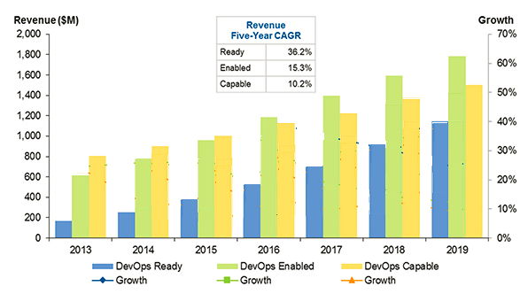
DevOps Awareness Pattern in IT Industry
Source: Gartner 2016

Slide 22
Thank You

